Slide 1
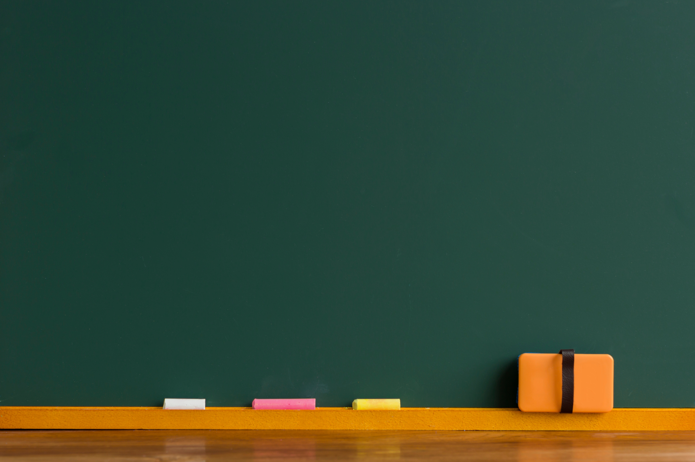
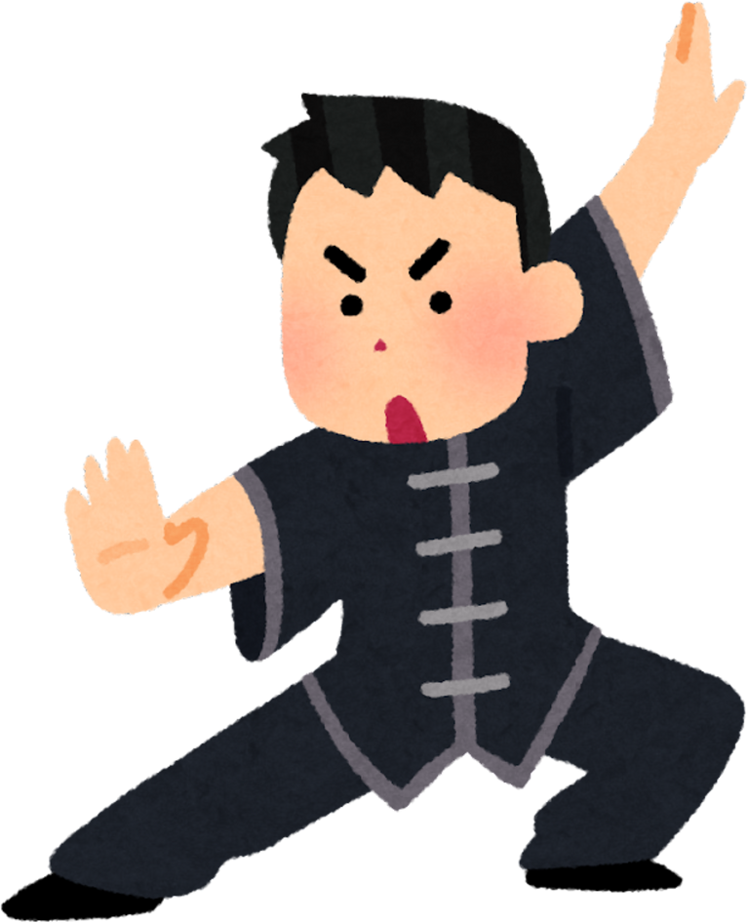
Python Programming Summer Camp
Class # 5
Functions -
Teach the Computer a New Trick
I know Kungfu
By Asim Munawar

Slide 2
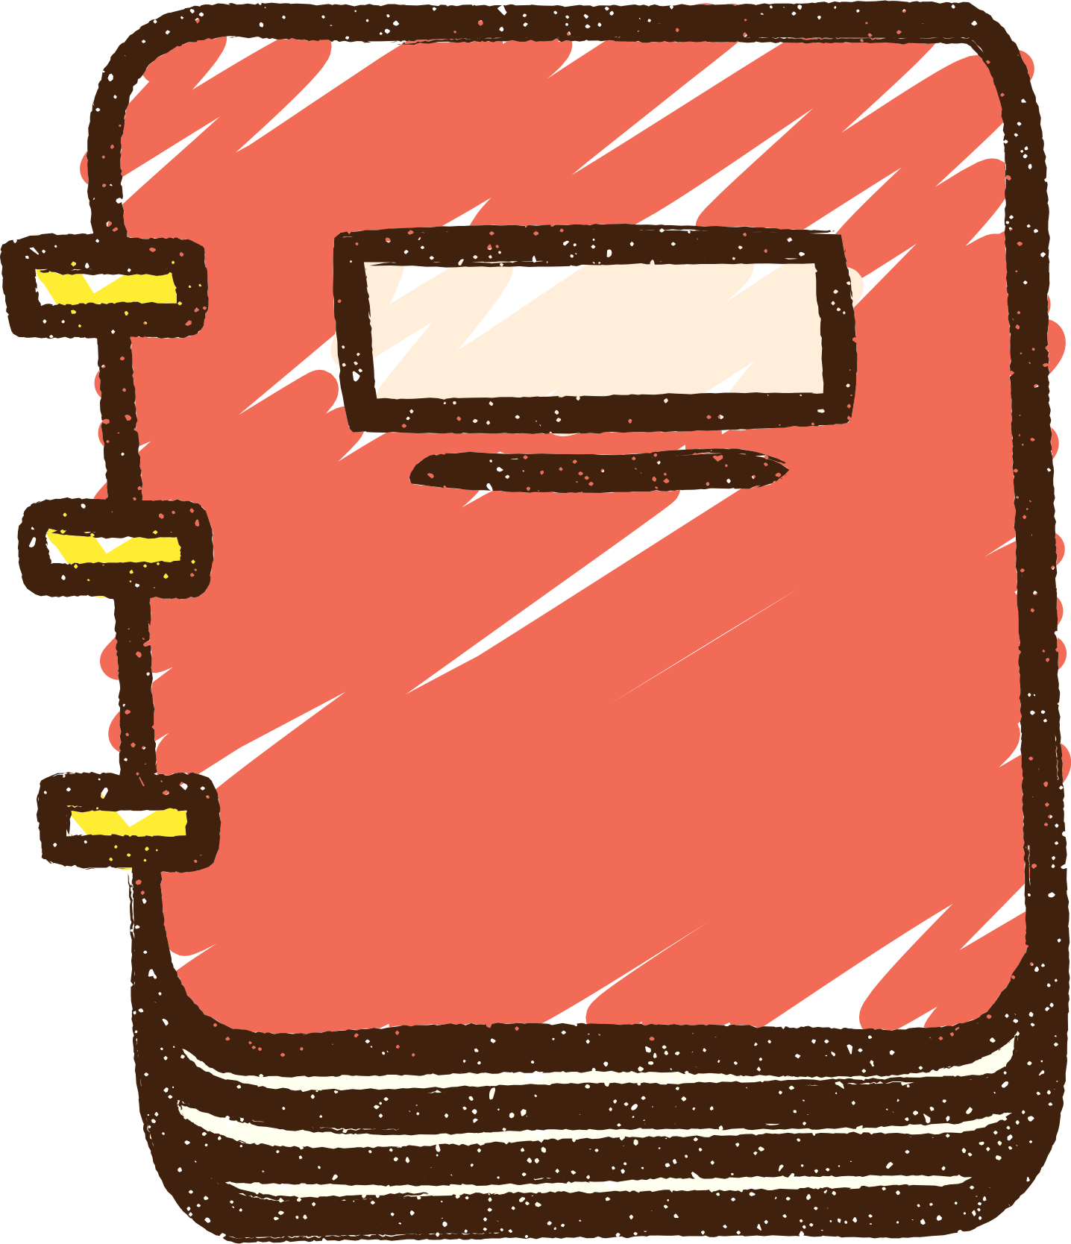
Course Plan
Lesson 1: Printing Fun – Say Hello to Python
Lesson 2: Variables – Remembering Things in Code
Lesson 2: If/Else – Making Decisions
Lesson 3: Loops – Doing Things Again and Again / Inputs
Lesson 4: Lists – Collecting Many Things
Lesson 5: Functions – Teach the Computer a New Trick
Lesson 6: Files – Saving and Reading Data
Lesson 7: Simple App with Gradio – Make Your Own Tool
Lesson 8: Final Project – Build and Present Your App

Slide 3


Font for Programming
Courier New OS
Comic Sans
print("Item Quantity Price")
print("----------------------------")
print("Apples 10 $2.50")
print("Bananas 5 $1.20")
print("Oranges 12 $3.00")
print("Grapes 1 $4.00")
print("Item Quantity Price")
print("----------------------------")
print("Apples 10 $2.50")
print("Bananas 5 $1.20")
print("Oranges 12 $3.00")
print("Grapes 1 $4.00")

Slide 4
🔧 What is a Function?
A function is a block of code that runs when you call it.
We use functions to avoid repeating code and to stay organized.
We define a function using the def keyword.

Slide 5
How to Build a Function
def → Tells Python you are defining a function
Function Name → The name you give to the function (e.g., greet)
Parameters → Inside ( ), values the function can use
Colon (:) → Ends the function header
Indented Block → The body or code that runs
return → (Optional) Sends back a result
Example:
def add(num1, num2):
result = num1 + num2
return result

Slide 6
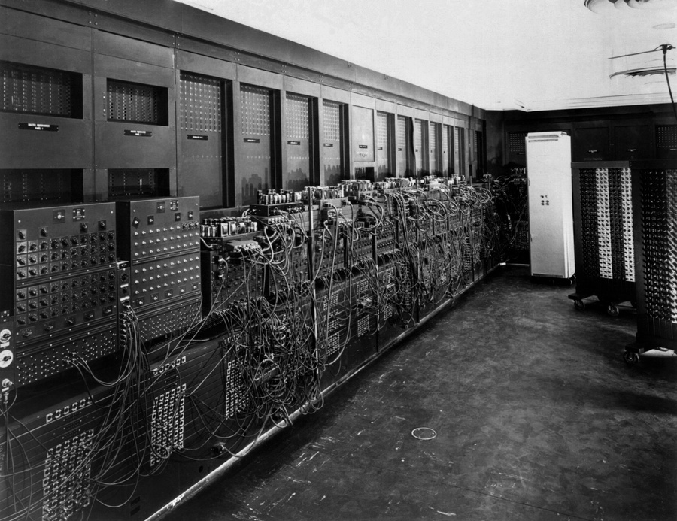
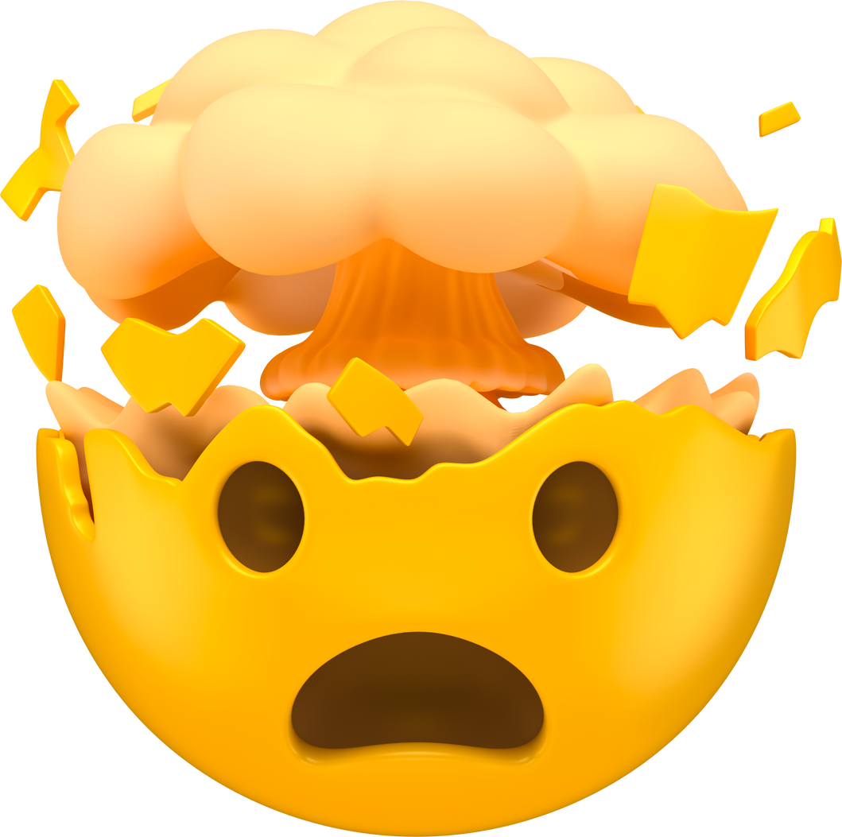
Fun Facts
The first electronic, digital computer was the ENIAC, developed in 1945
The first ever function was written in the 1800s by Ada Lovelace — often called the world’s first programmer!

Slide 7
Simple function
# no return, no parameter
def greet():
print("Welcome to Python class!")
greet()
greet()
Functions can take inputs (parameters) so they work with different values.
# 📥 Parameters are like blanks to fill in when you call the function.
def greet(name):
print("Hi", name + "!")
greet("Asim")
greet("Zahid")
Functions that Return Values
# A function can also give back (return) an answer.
def double(x):
return x * 2
result = double(4)
print(result)
A function only runs when you call it

Slide 8

Lets create a useful function
# convert celsius to fahrenheit
def celsius_to_fahr(temp):
return ((temp * 9/5) + 32)
print("0 degree C is", celsius_to_fahr(0), "in F")
print("100 degree C is", celsius_to_fahr(100), "in F")
print("38 degree C is", celsius_to_fahr(38), "in F")

Slide 9
Fun Fact
In Python, even print() is a function — you’ve been using functions from Day 1!
You can even make a function that calls itself — it’s called recursion!
Think of functions like superpowers — you write it once and reuse it everywhere!

Slide 10
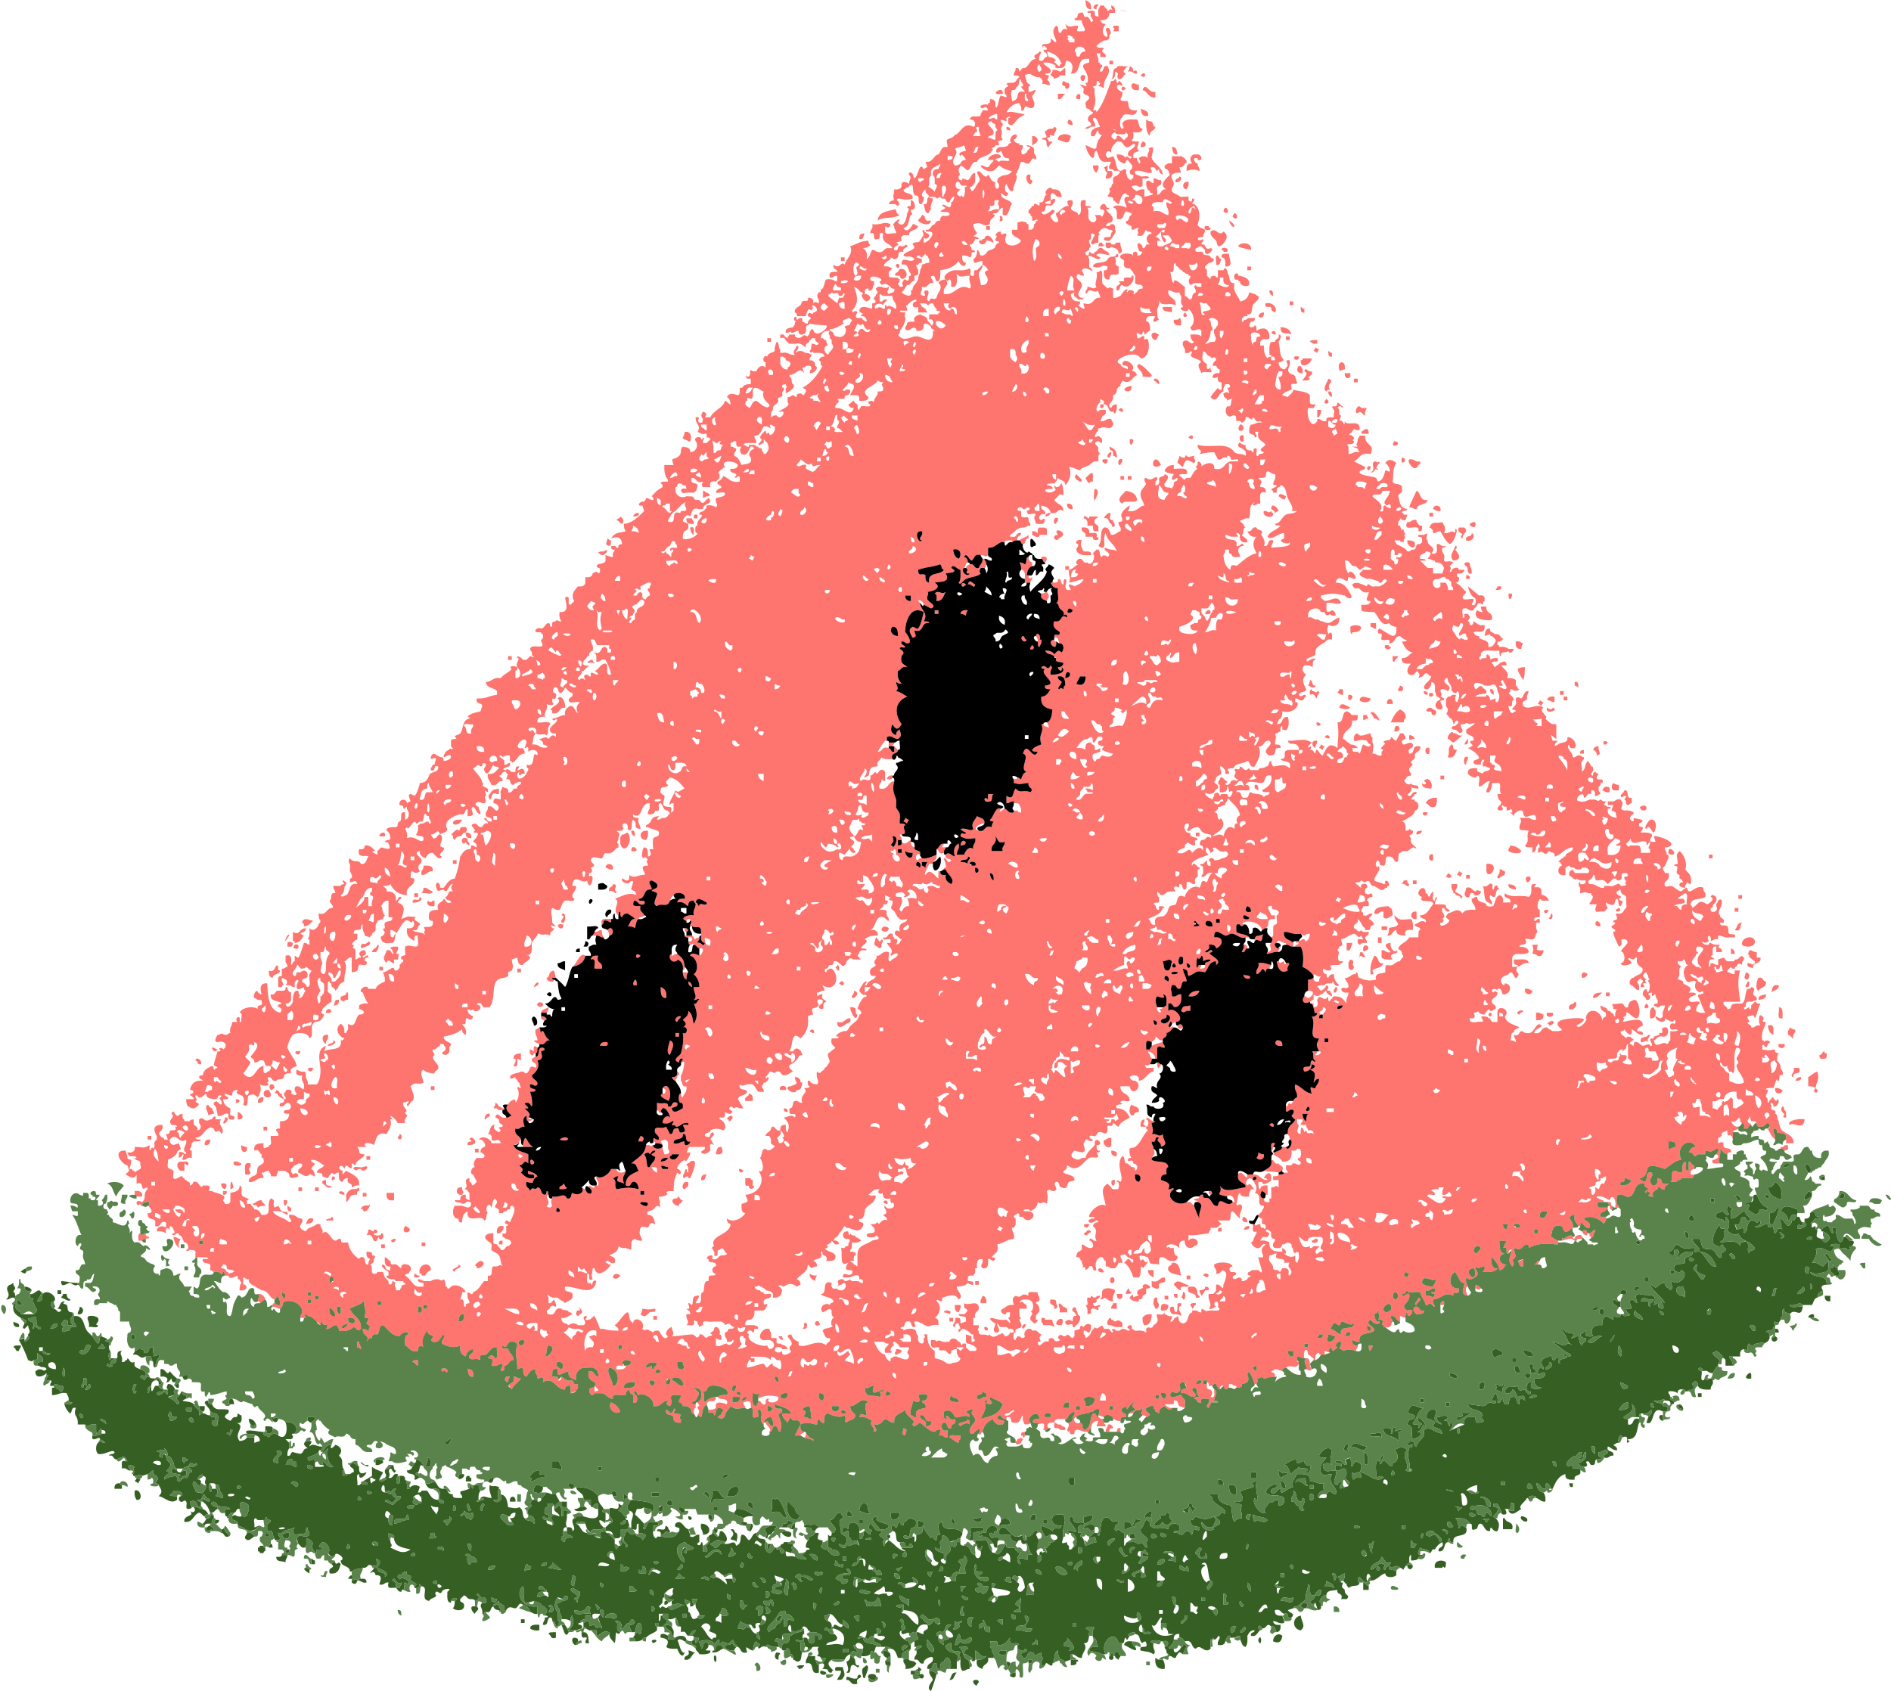
Functions + Loops + If/Else
🧩 Functions work great with loops, input, lists, and conditions!
def check_even_odd(numbers):
for n in numbers:
if n % 2 == 0:
print(n, "is Even")
else:
print(n, "is Odd")
check_even_odd([1, 4, 7, 10])

Slide 11
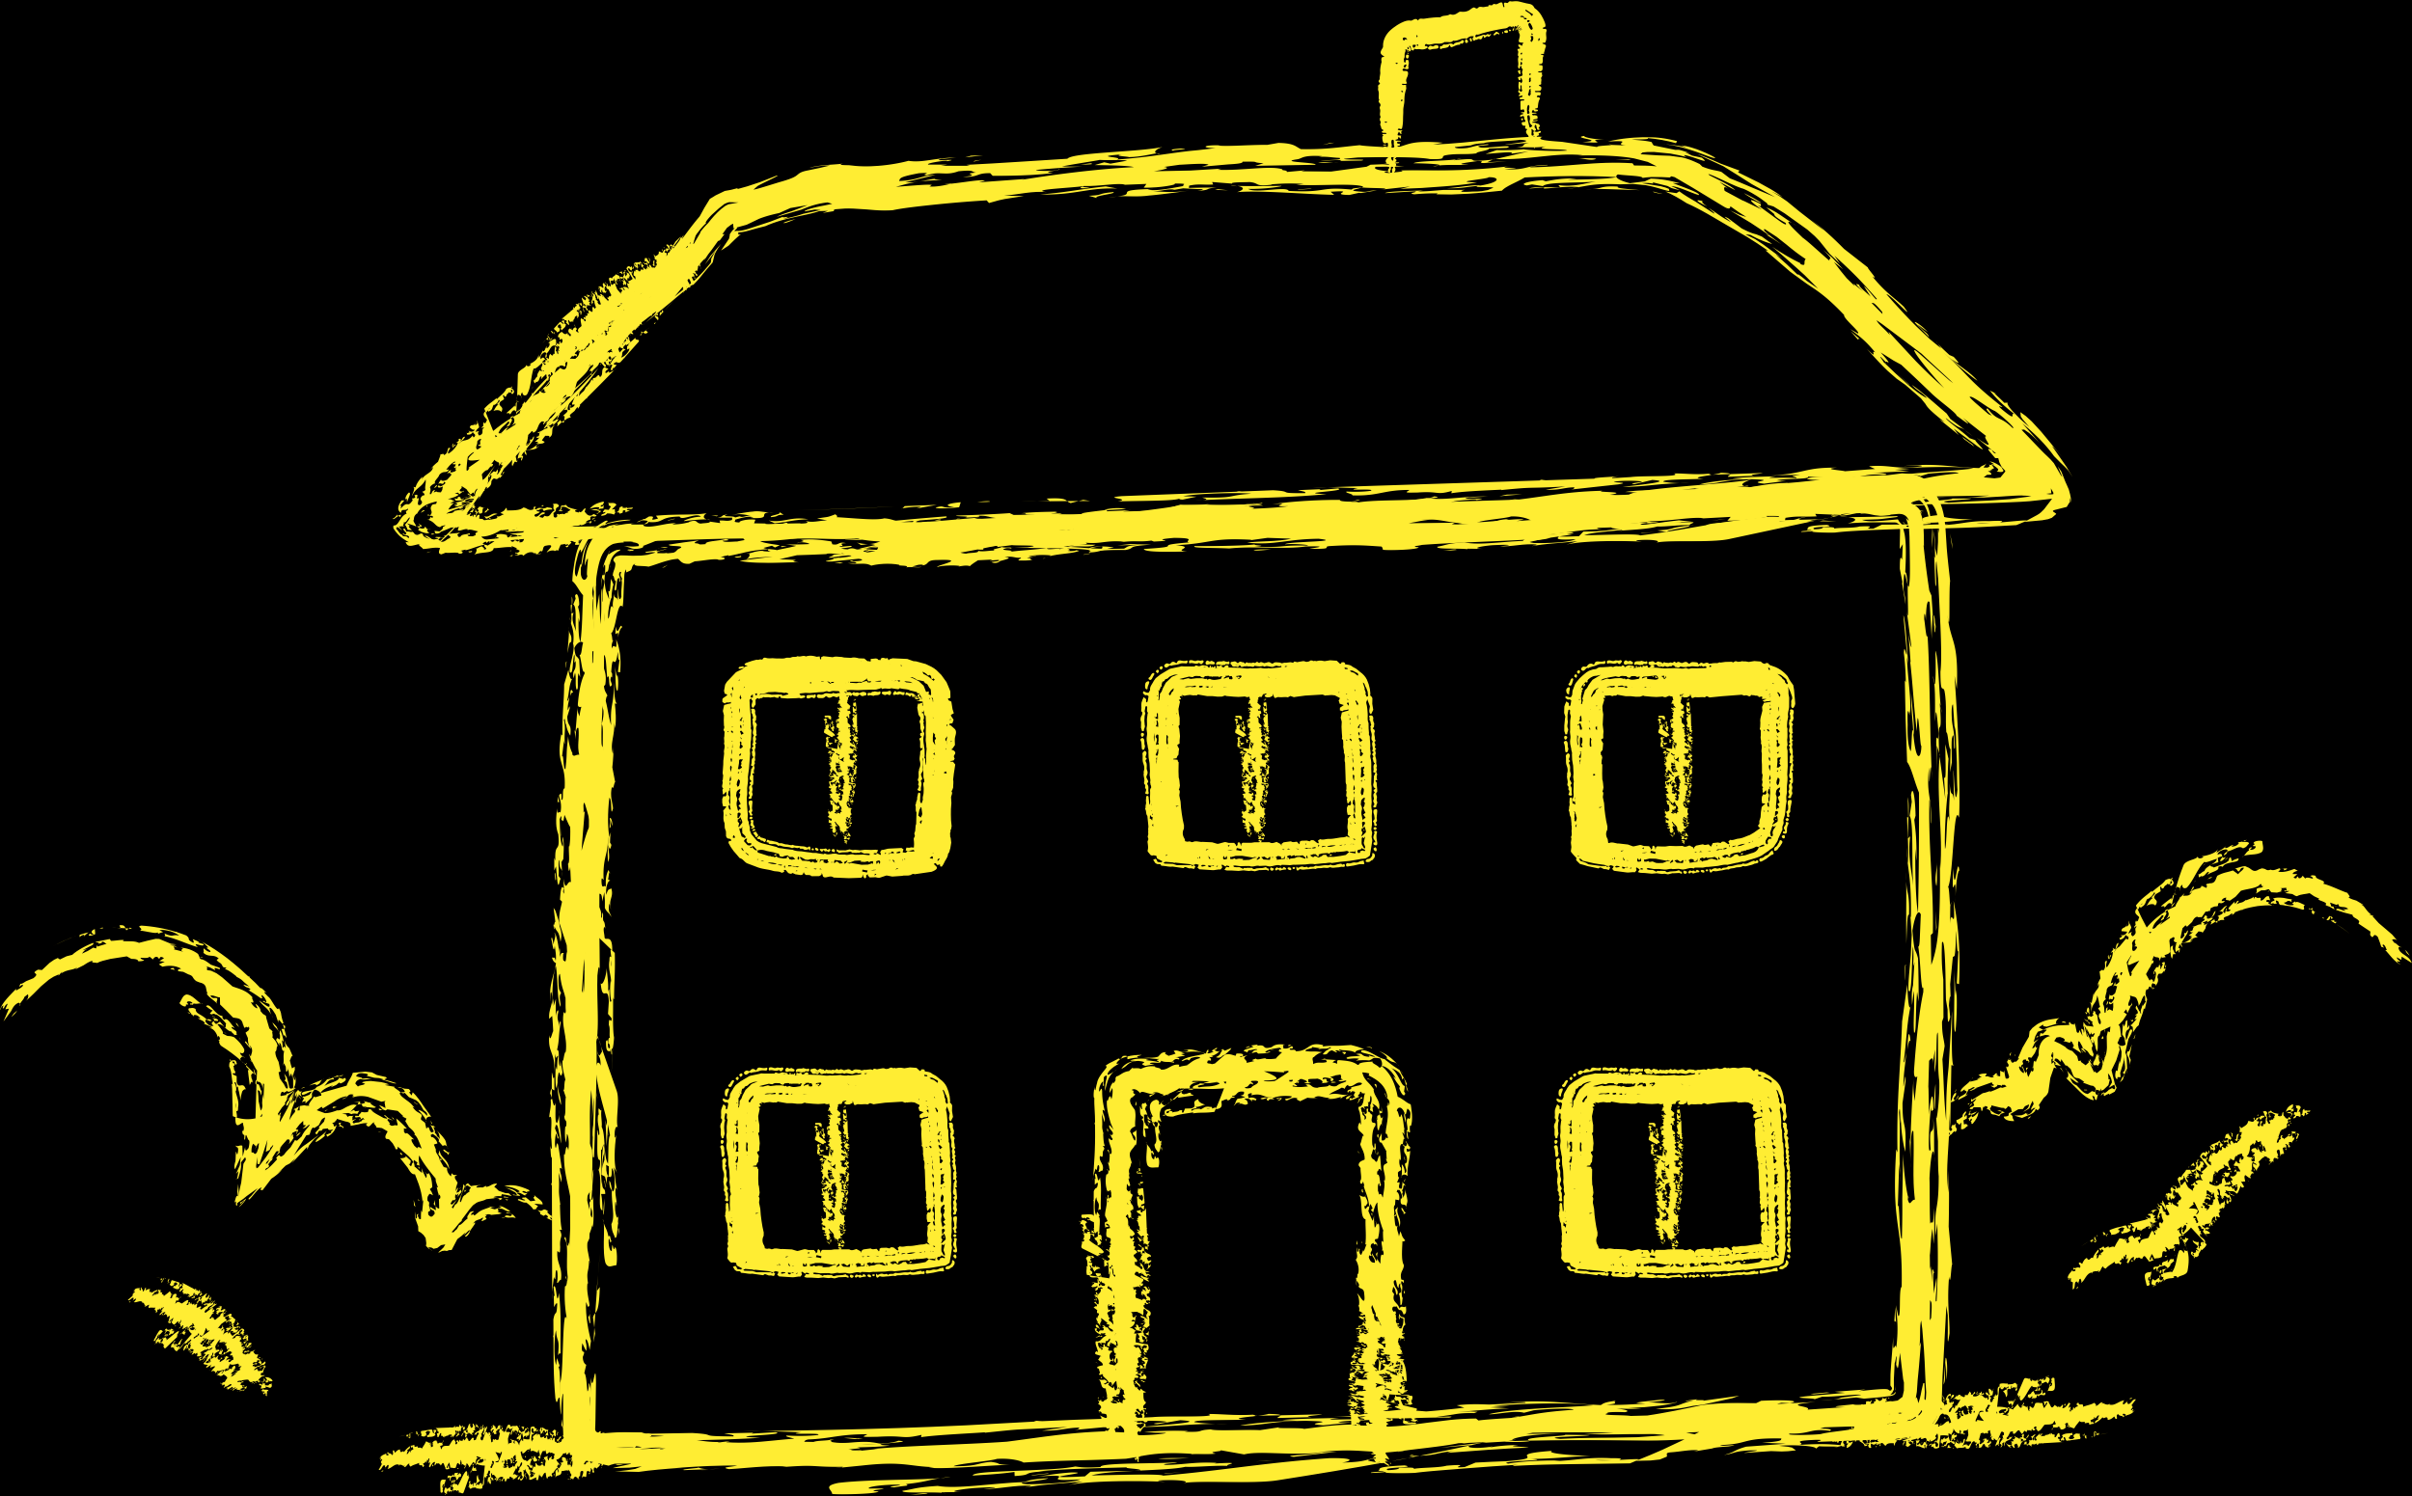
Homework
1. 🎉 Say Welcome
Write a function called say_welcome that prints:
"🎈 Welcome to our Python class!"
Call it two times.
2. 🧁 Favorite Dessert
Write a function called favorite_dessert(dessert) that prints:
"Yum! I love <dessert> too!"
Try it with "cake", "ice cream", and "donuts".
3. 🧮 Triple the Fun
Write a function triple(number) that returns 3 times the number.
Call it with 4, 7, and 10, and print the results.
4. 🐾 Animal Sound
Write a function make_sound(animal) that prints:
"The <animal> goes ..." and you decide the sound.
Try with "dog", "cat", and "duck".
5. 🗓️ Miles to Km converter
Write a function miles_to_km(miles) that converts miles to km
🌟 Bonus Challenge: 💬 Echo Machine
Write a function echo(word, times) that prints the word many times using a loop.
Example: echo("Hi!", 3) prints "Hi!" three times.

Slide 12


Thank You

